Slide 1
Building a Simple Network
Understanding the Host-to-Host Communications Model

Slide 2
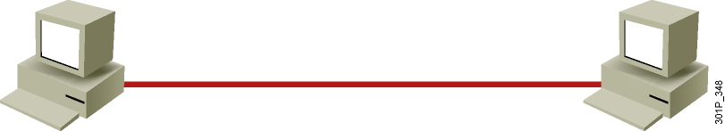
Understanding Host-to-Host Communications
  Older model
    Proprietary
    Application and combinations software controlled by one vendor
  Standards-based model
    Multivendor software
    Layered approach

Slide 3
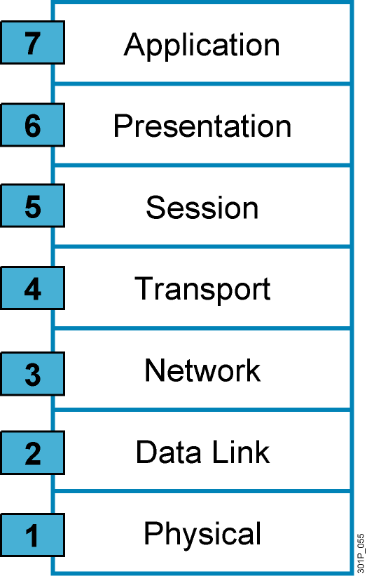
Why a Layered Network Model?
  Reduces complexity
  Standardizes interfaces
  Facilitates modular engineering
  Ensures interoperable technology
  Accelerates evolution
  Simplifies teaching and learning
Notes:
Lesson Aim
<Enter lesson aim here.>

Slide 4
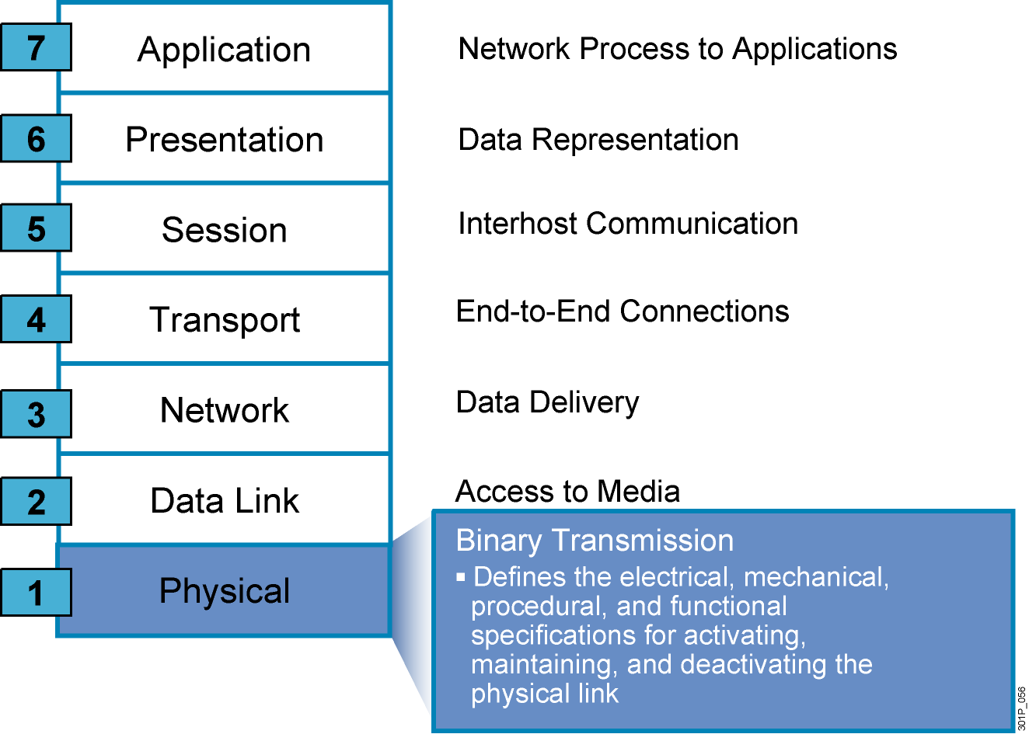
The Seven Layers of the OSI Model
Notes:
Lesson Aim
<Enter lesson aim here.>

Slide 5
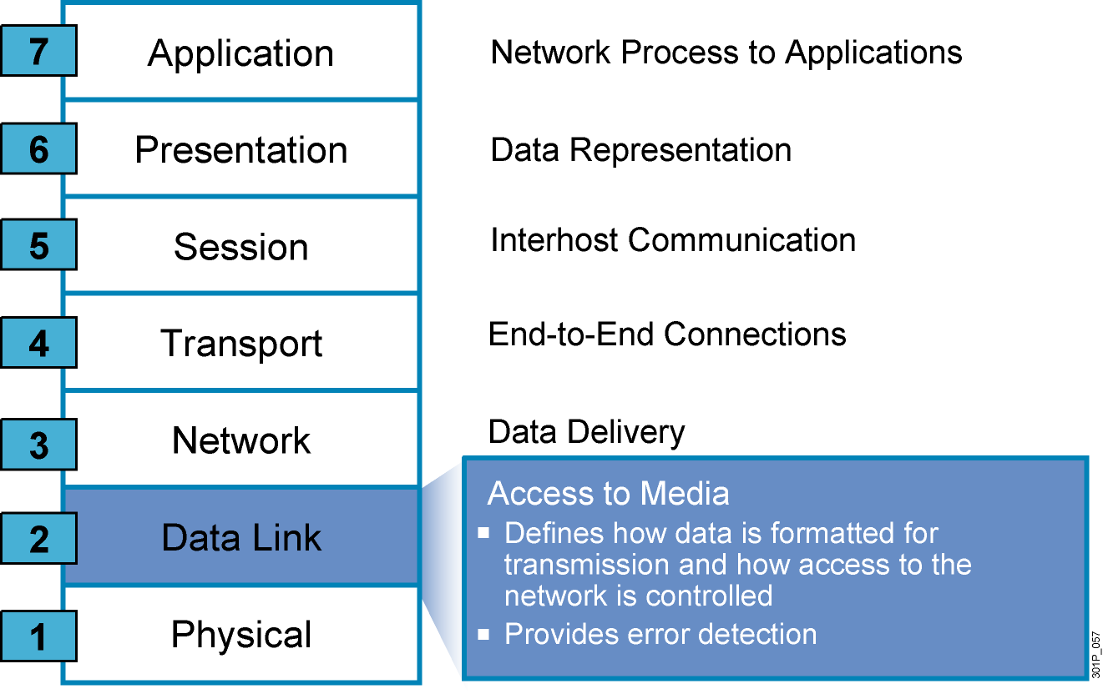
The Seven Layers of the OSI Model (Cont.)
Notes:
Lesson Aim
<Enter lesson aim here.>

Slide 6
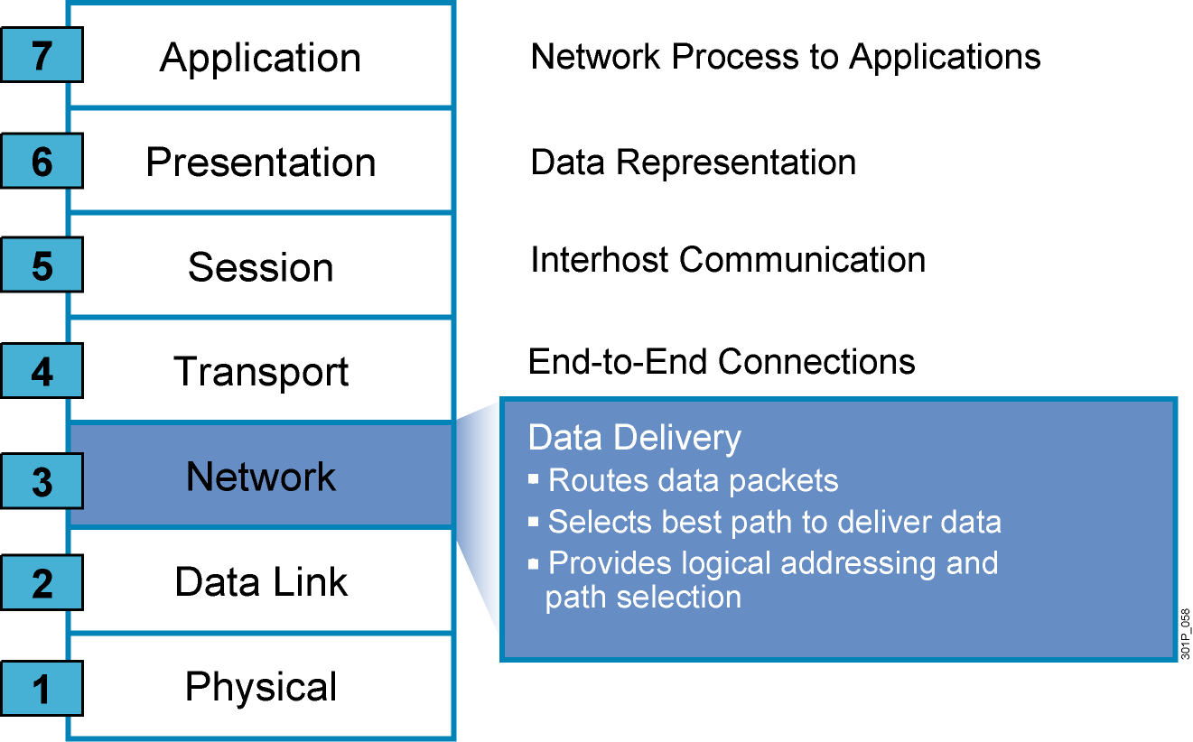
The Seven Layers of the OSI Model (Cont.)
Notes:
Lesson Aim
<Enter lesson aim here.>

Slide 7
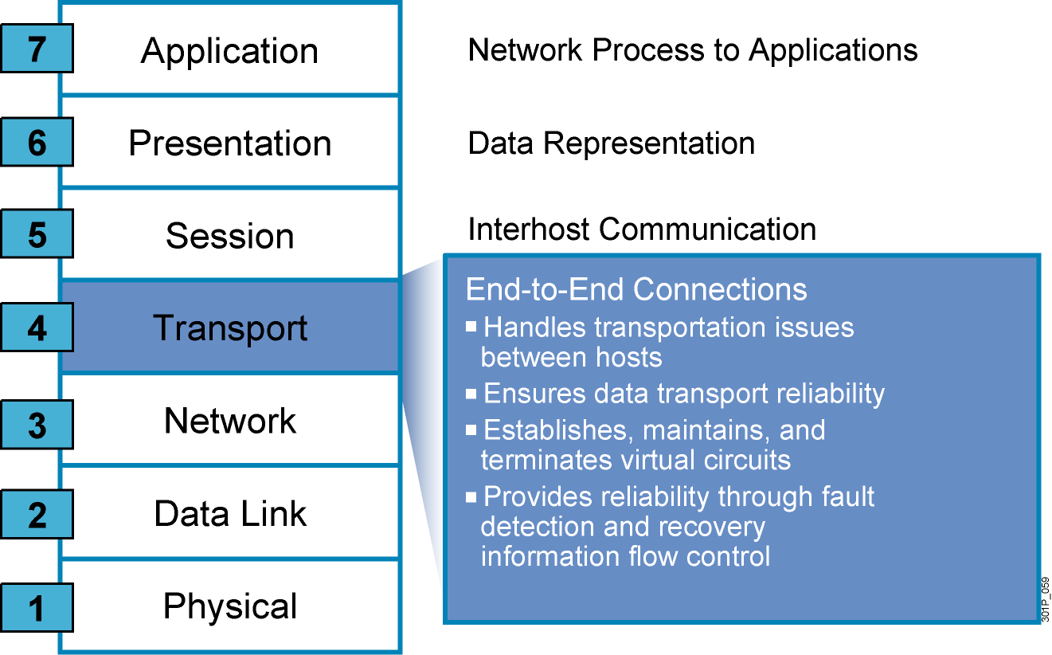
The Seven Layers of the OSI Model (Cont.)
Notes:
Lesson Aim
<Enter lesson aim here.>

Slide 8
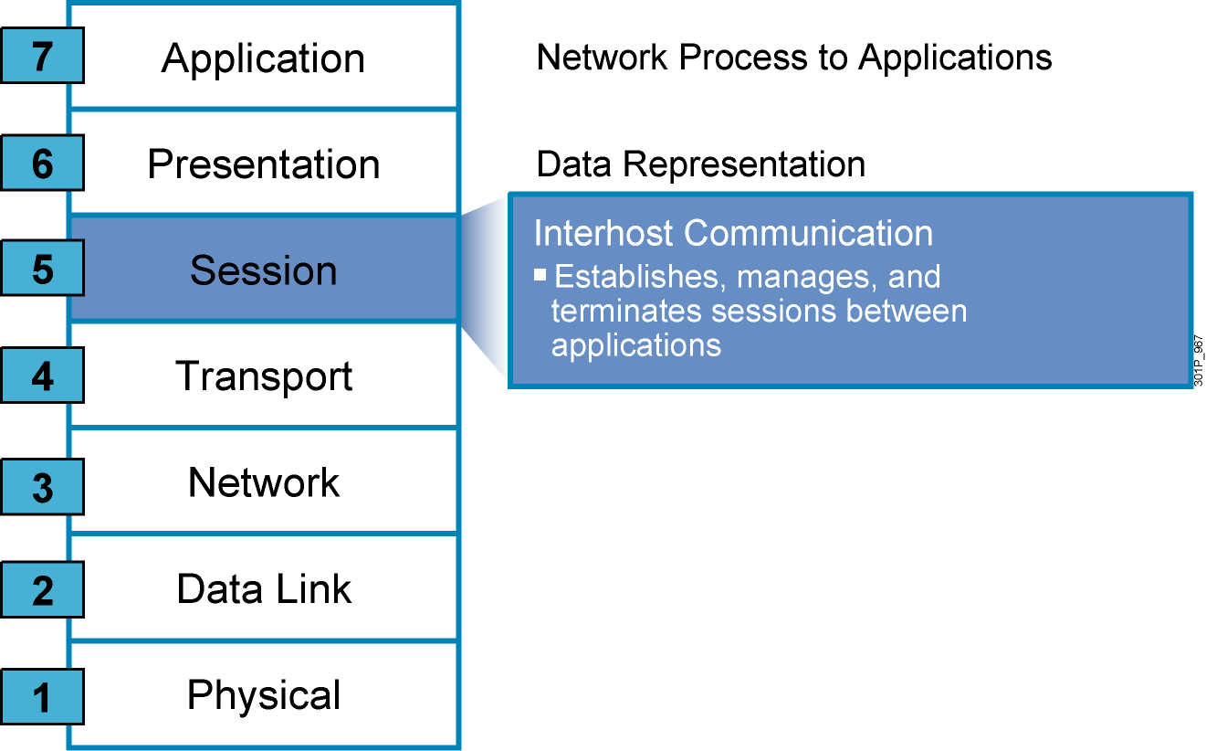
The Seven Layers of the OSI Model (Cont.)
Notes:
Lesson Aim
<Enter lesson aim here.>

Slide 9
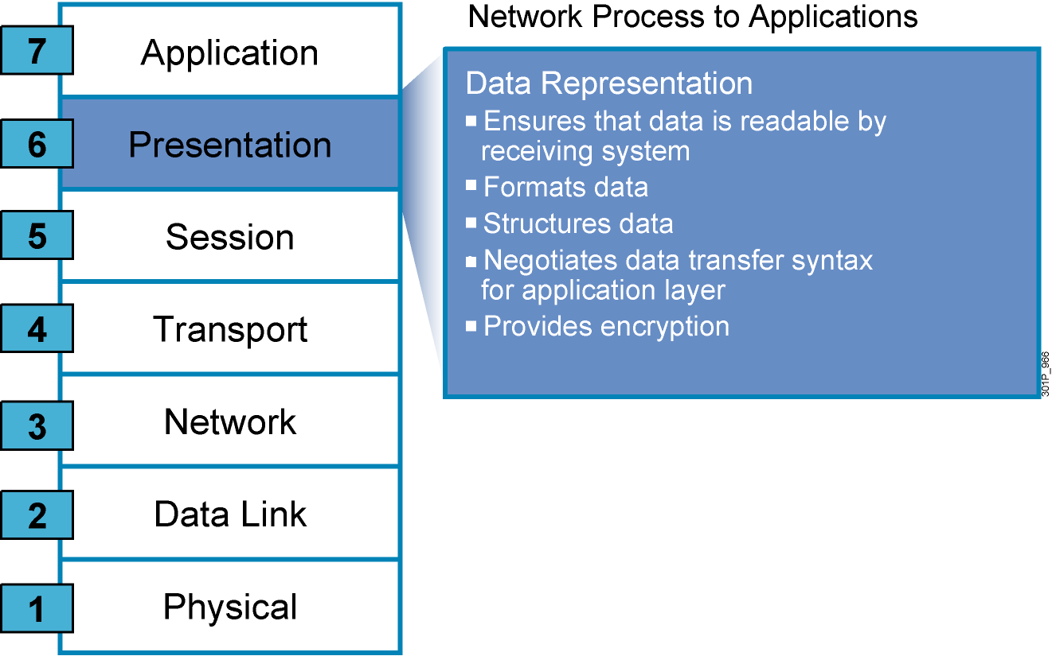
The Seven Layers of the OSI Model (Cont.)
Notes:
Lesson Aim
<Enter lesson aim here.>

Slide 10
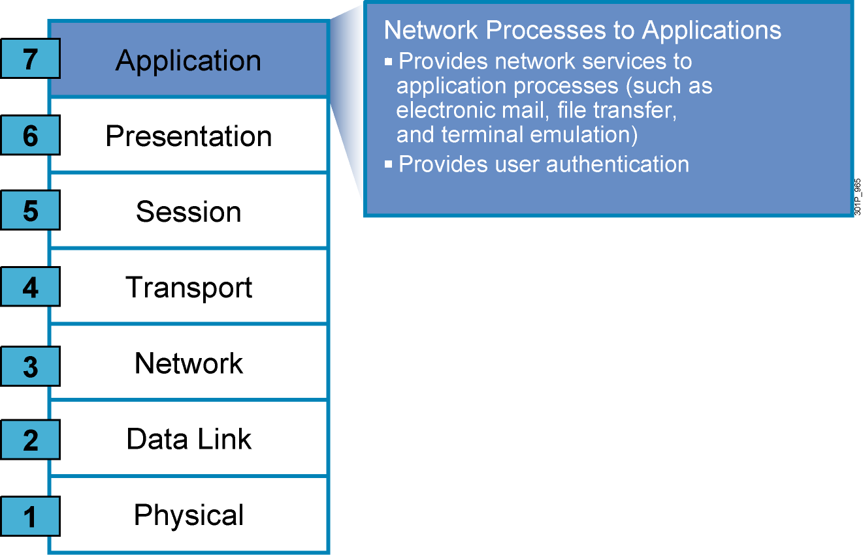
The Seven Layers of the OSI Model (Cont.)
Notes:
Lesson Aim
<Enter lesson aim here.>

Slide 11
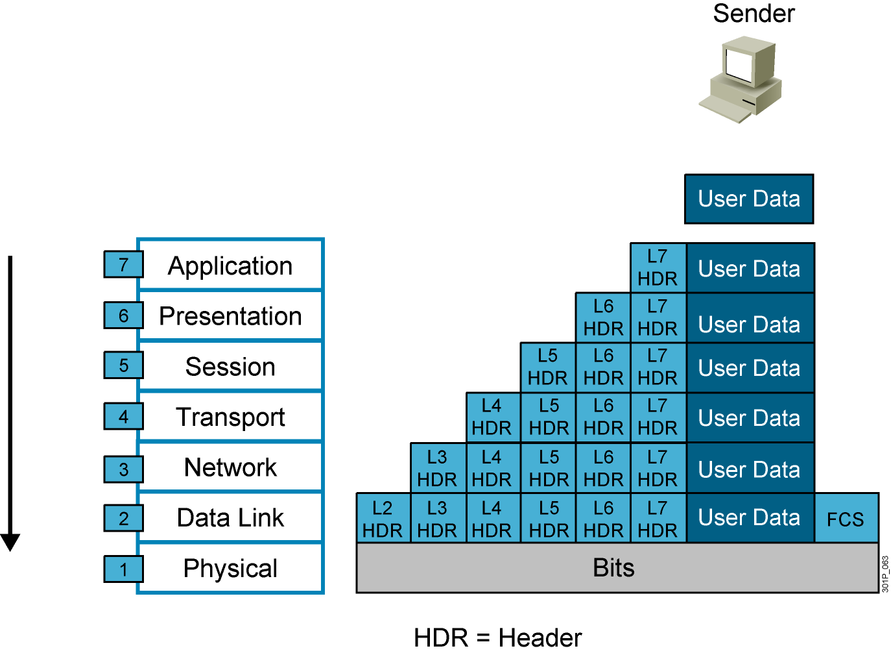
Data Encapsulation
Notes:
Lesson Aim
<Enter lesson aim here.>

Slide 12

Data De-Encapsulation
Notes:
Lesson Aim
<Enter lesson aim here.>

Slide 13
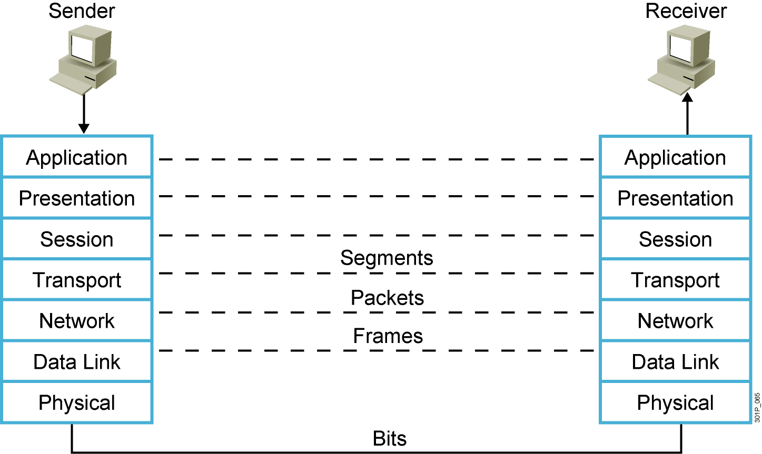
Peer-to-Peer Communication
Notes:
Lesson Aim
<Enter lesson aim here.>

Slide 14
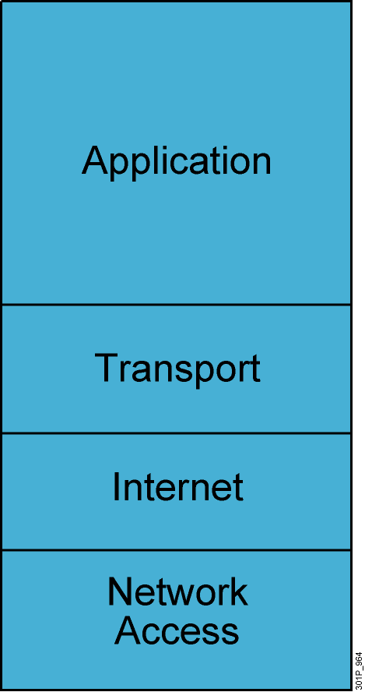
TCP/IP Stack
  Defines four layers
  Uses different names for Layers 1 through 3
  Combines Layers 5 through 7 into single application layer
Notes:
Lesson Aim
<Enter lesson aim here.>

Slide 15
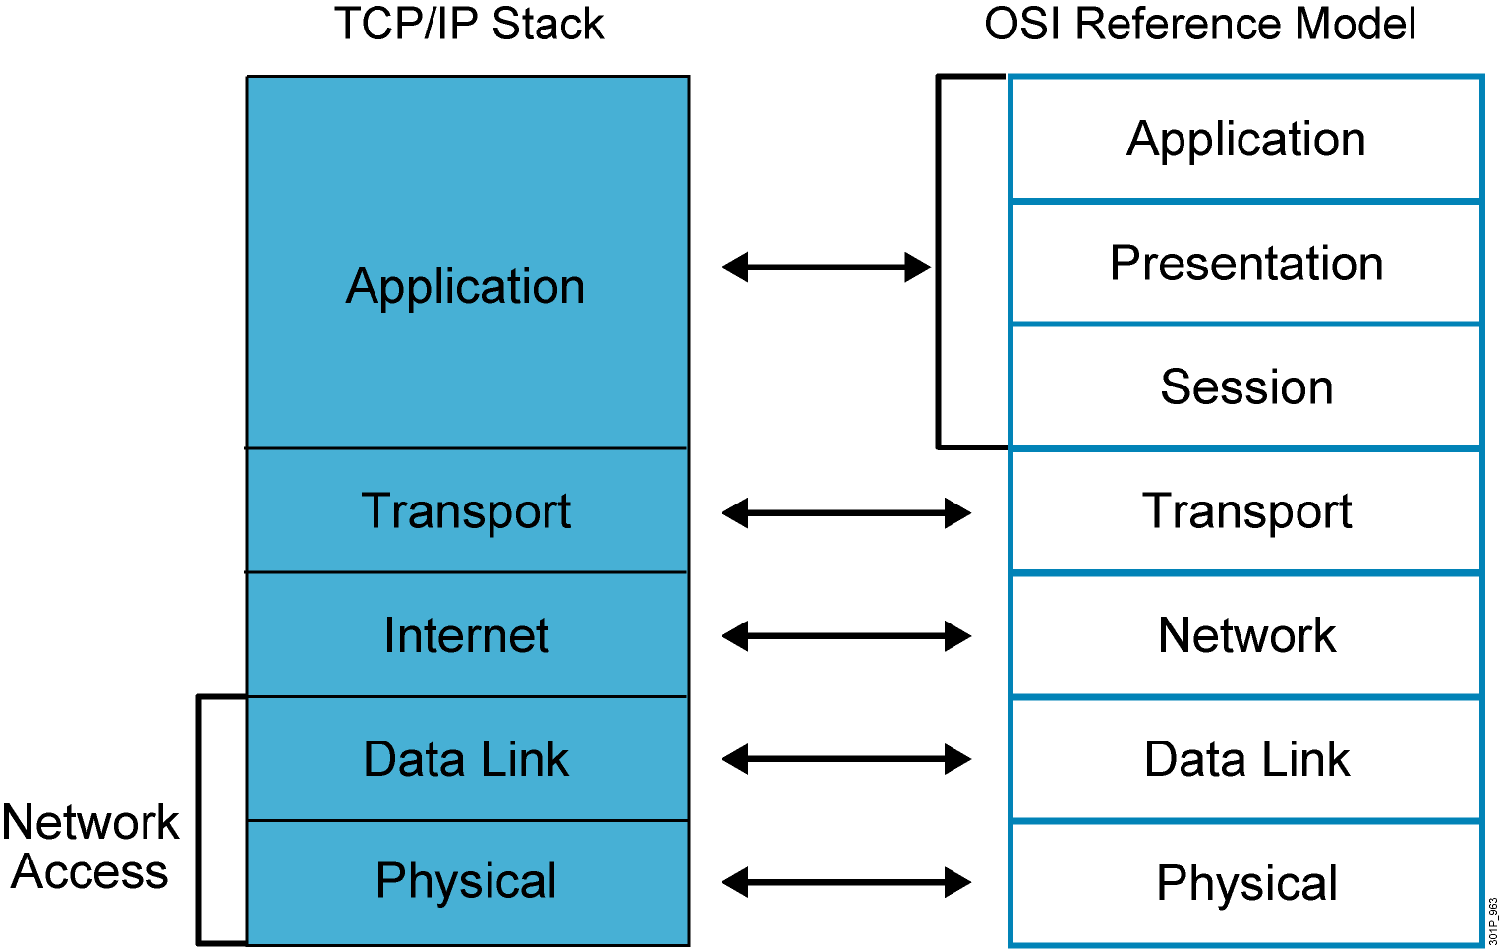
TCP/IP Stack vs. the OSI Model

Slide 16
Summary
  The OSI reference model defines the network functions that occur at each layer.
  The physical layer defines the electrical, mechanical, procedural, and functional specifications for activating, maintaining, and deactivating the physical link between end systems.
  The data link layer defines how data is formatted for transmission and how access to the physical media is controlled.
  The network layer provides connectivity and path selection between two host systems that may be located on geographically separated networks.

Slide 17
Summary (Cont.)
  The transport layer segments data from the system of the sending host and reassembles the data into a data stream on the system of the receiving host.
  The session layer establishes, manages, and terminates sessions between two communicating hosts.
  The presentation layer ensures that the information sent at the application layer of one system is readable by the application layer of another system.
  The application layer provides network services to the applications of the user, such as e-mail, file transfer, and terminal emulation.

Slide 18
Summary (Cont.)
  The information sent on a network is referred to as data or data packets. If one computer wants to send data to another computer, the data must first be packaged by a process called encapsulation.
  When the remote device receives a sequence of bits, the physical layer at the remote device passes the bits to the data link layer for manipulation. This process is referred to as de-encapsulation.

Slide 19
Summary (Cont.)
  TCP/IP is now the most widely used protocol for a number of reasons, including its flexible addressing scheme, its usability by most operating systems and platforms, its many tools and utilities, and the need to use it to connect to the Internet.
  The components of the TCP/IP stack are the network access, Internet, transport, and application layers.
  The OSI model and the TCP/IP stack are similar in structure and function, with correlation at the physical, data link, network, and transport layers. The OSI model divides the application layer of the TCP/IP stack into three separate layers.

